Slide 1


House of Shadows

Slide 2
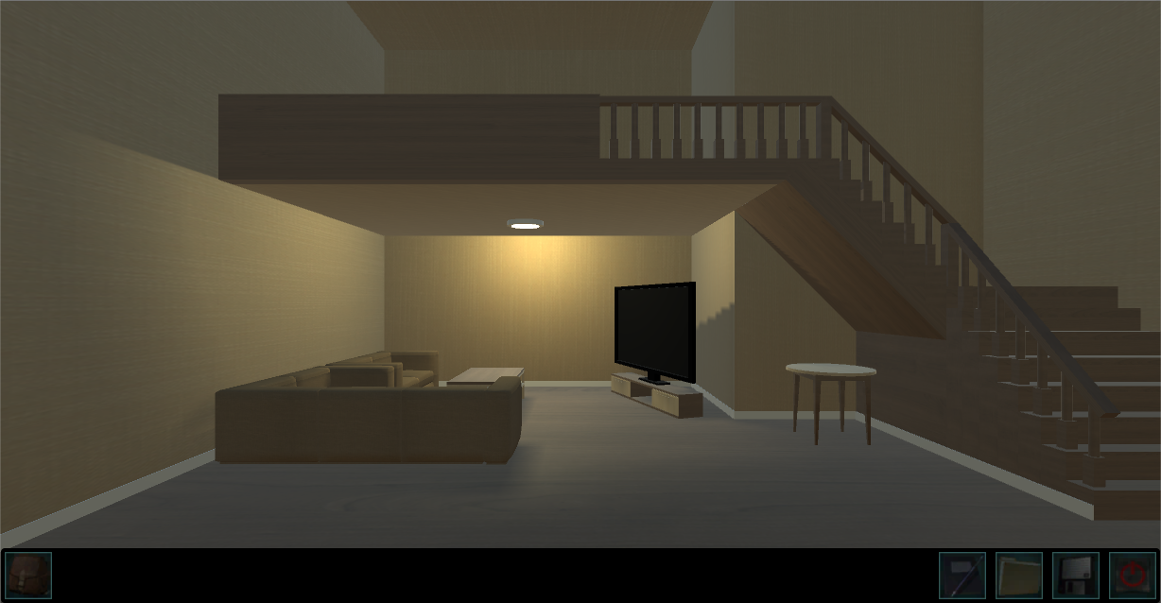
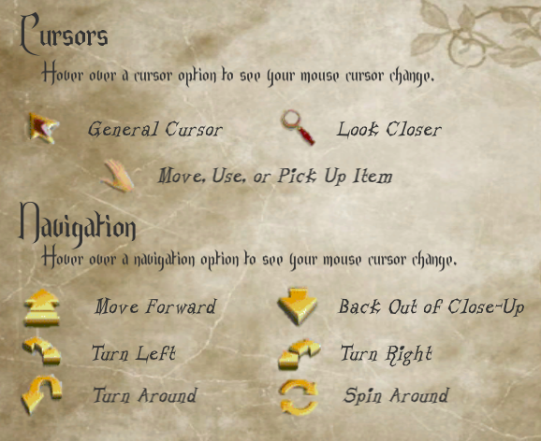
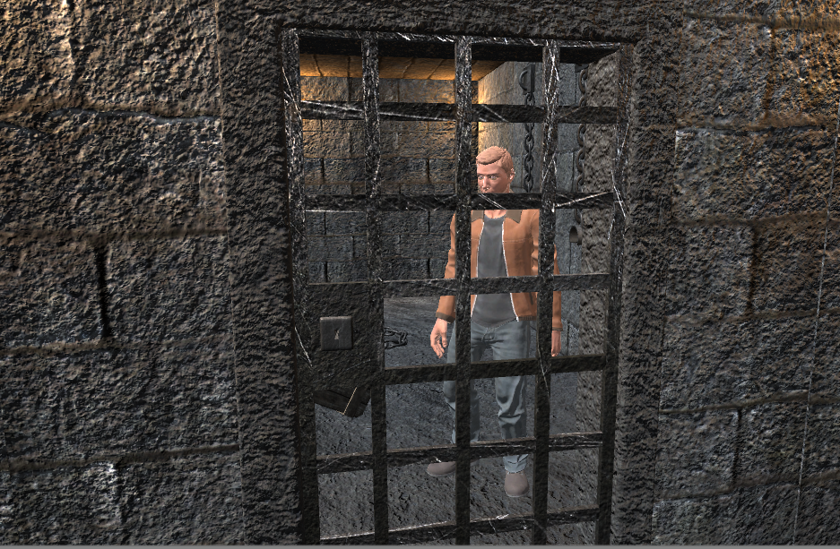
What is House of Shadows?
Single-Player Horror Adventure
Point-and-Click Gameplay
Solve the mystery of your lost twin by solving various puzzles and overcoming challenges.

Slide 3
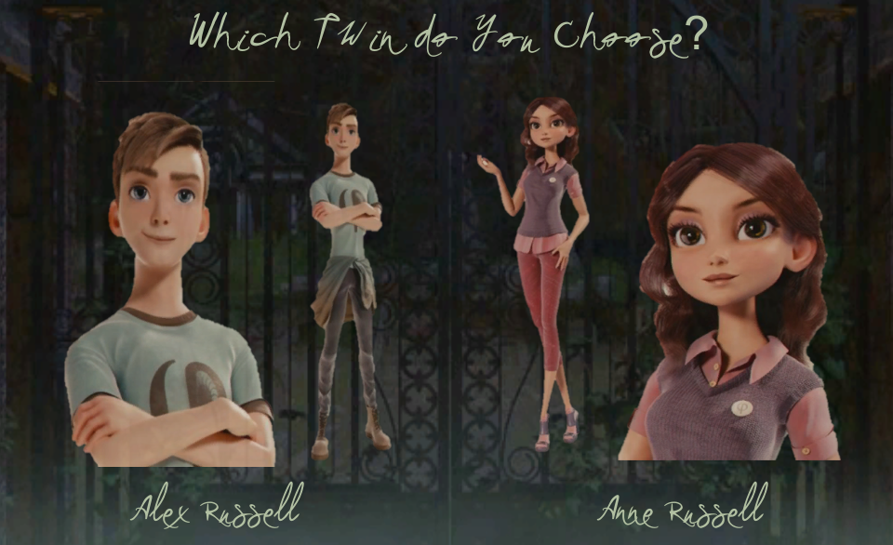
Begin by Choosing Your Character
With a dynamic narration feature,
the game will remember your
choice and will adapt gameplay
and dialogue to reflect which
character you have chosen, vs.
which character will then become
the missing sibling.

Slide 4
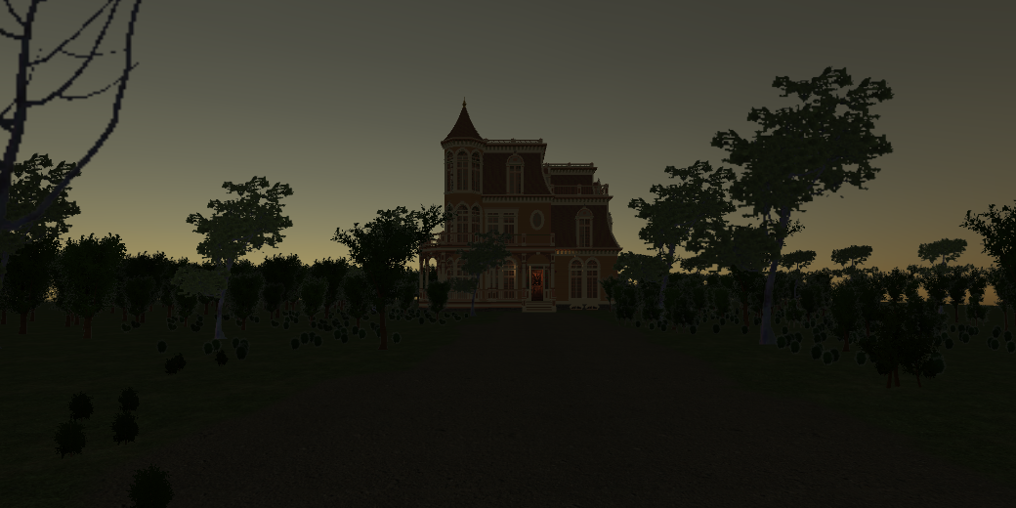
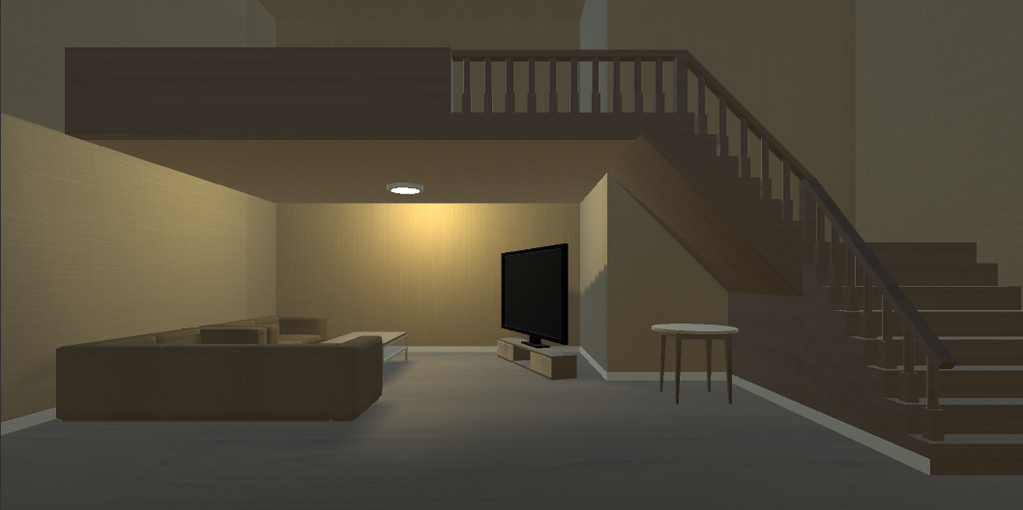
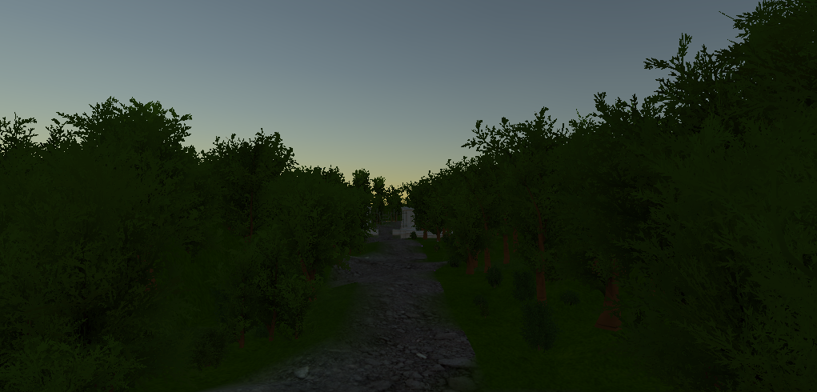
Levels
The game consists of several levels that the player may move through as they explore the house, and obtain certain items. The game begins at the player’s house and then transitions to the grounds around your sibling’s house, and finally inside their house.

Slide 5
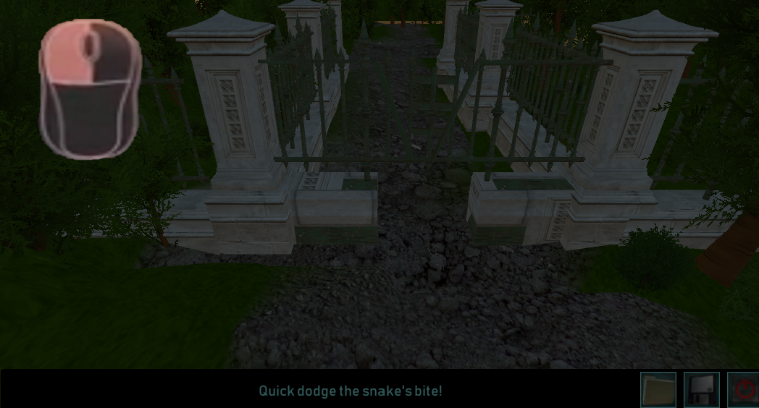
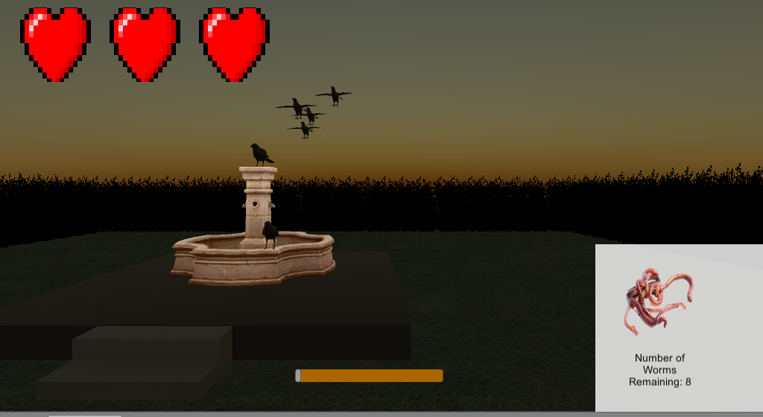
Minigames
The player must acquire items hidden throughout the game, and use them to complete various tasks to progress through the levels.

Slide 6
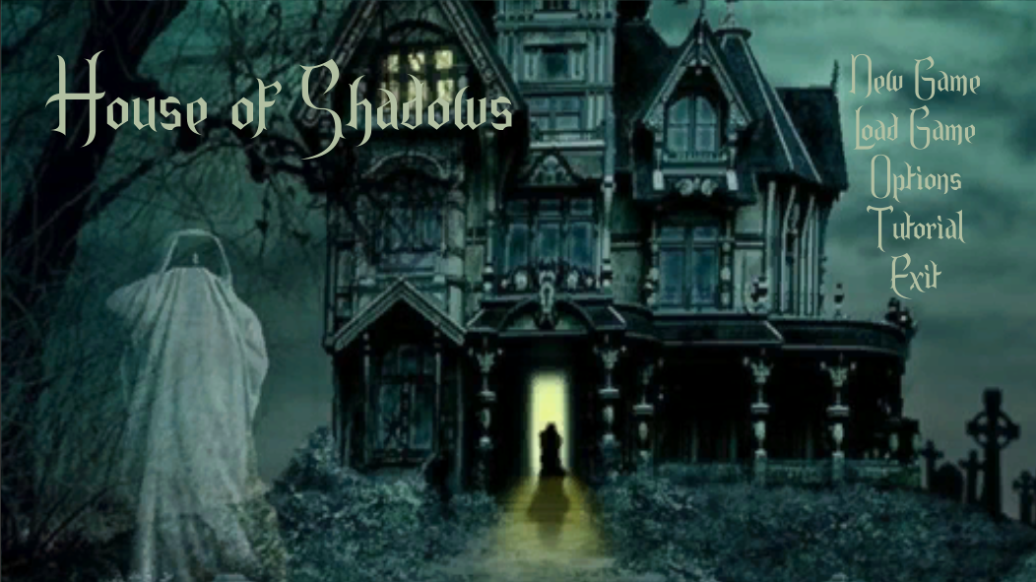
Menu and UI

Slide 7
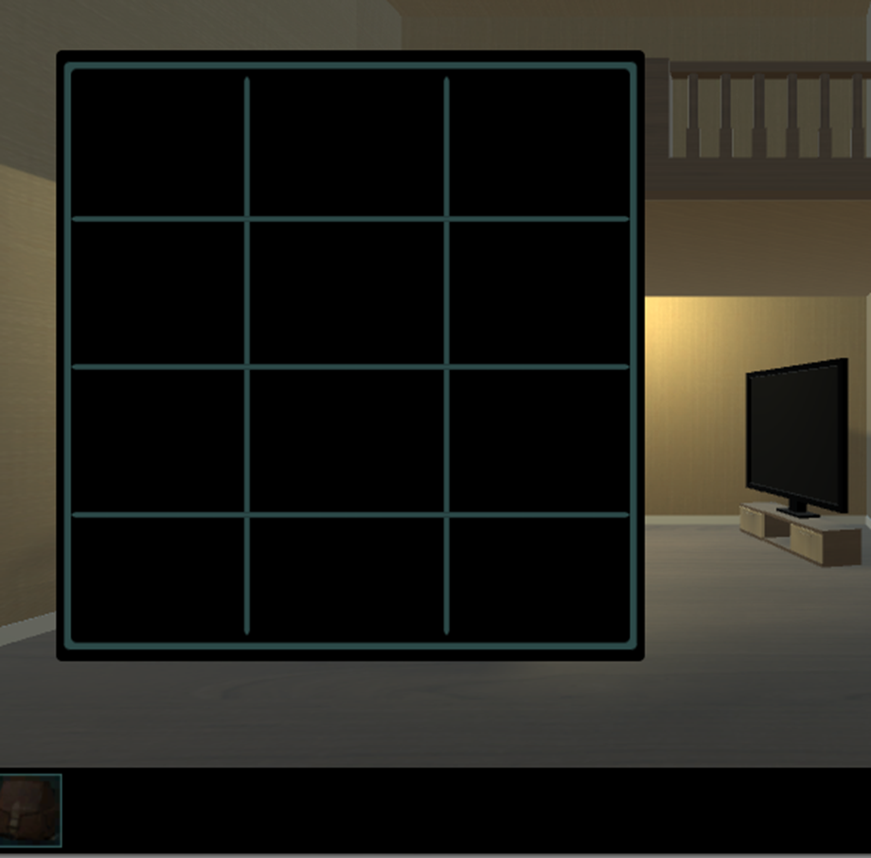
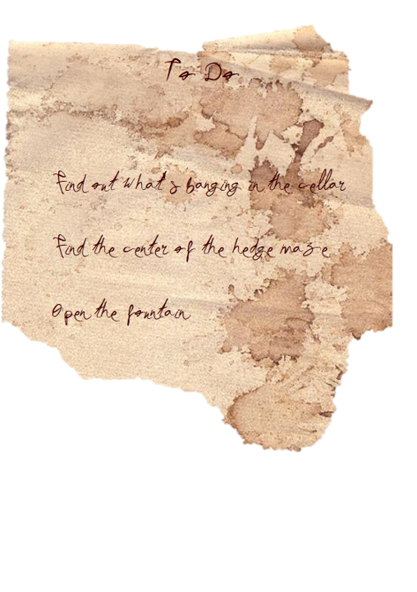







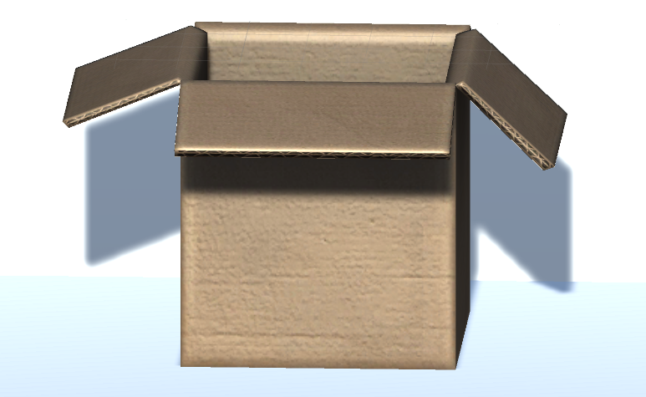
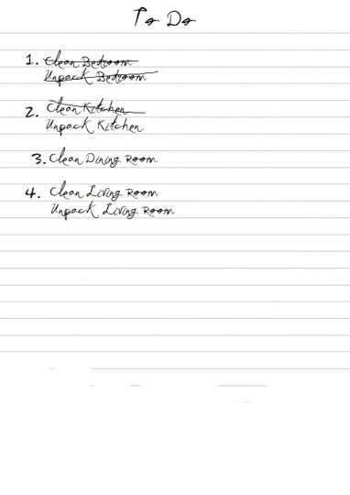
Inventory
The player must acquire ten items to progress through all of the levels available in the game. Once acquired the items will be viewable from the inventory screen, and often the player will be prompted to use the item, once they enter an area where it is necessary.

Slide 8
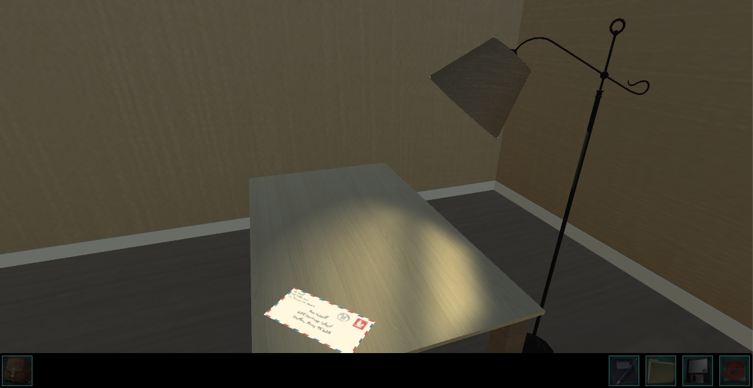
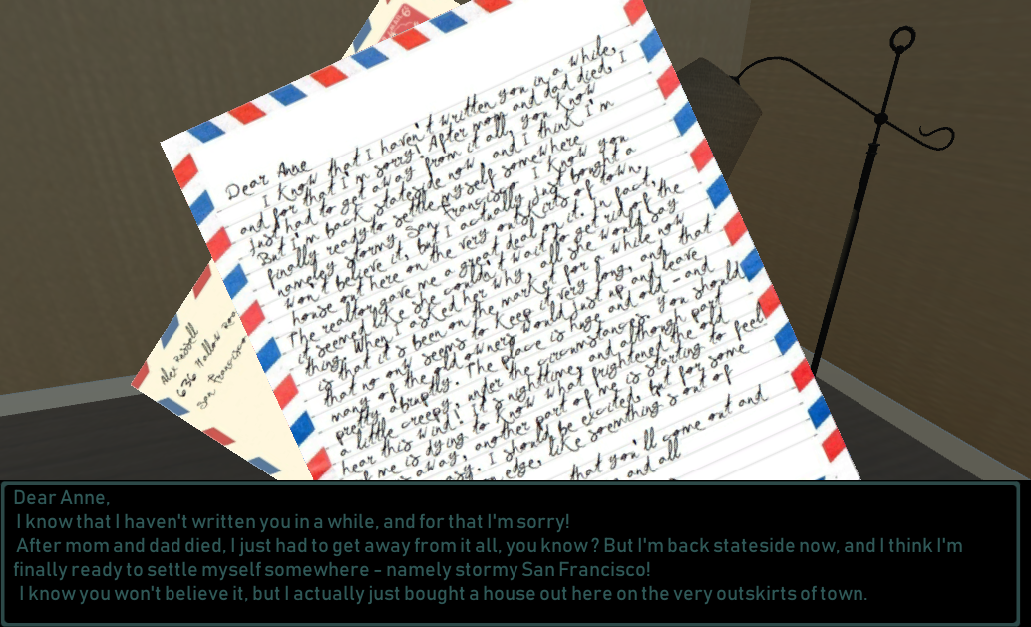
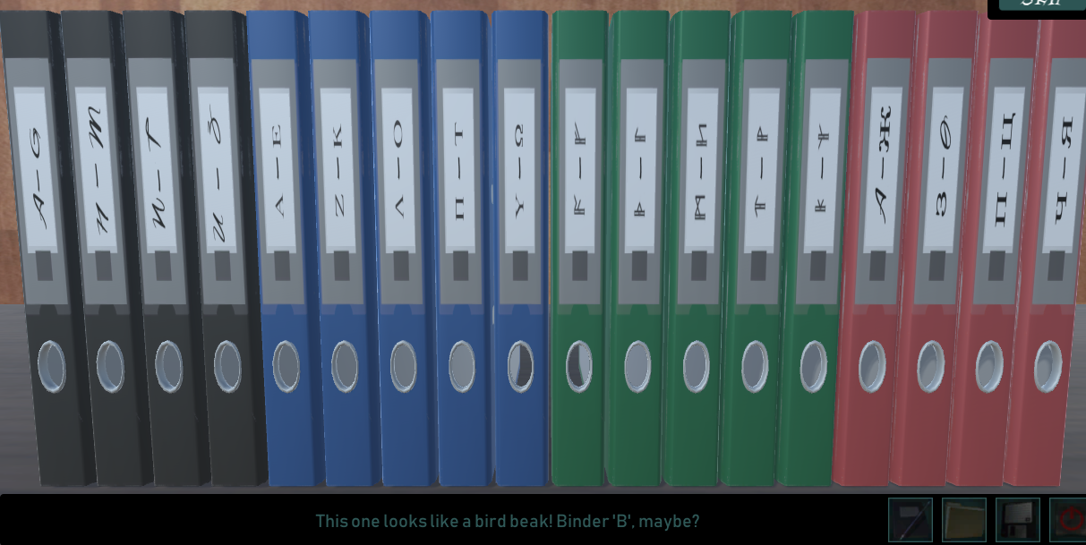
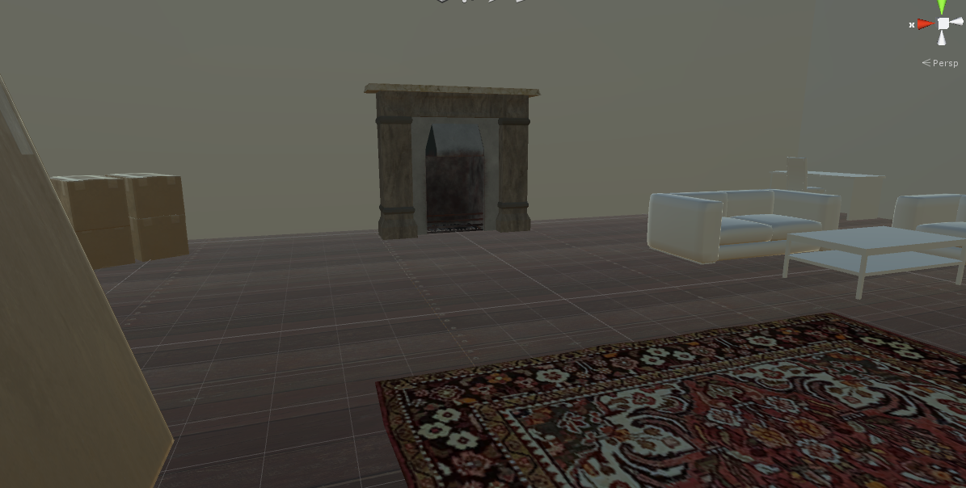
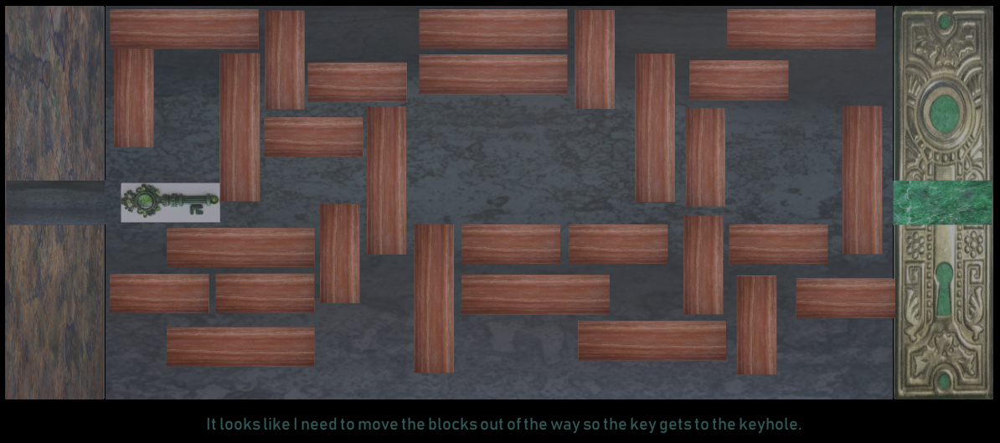
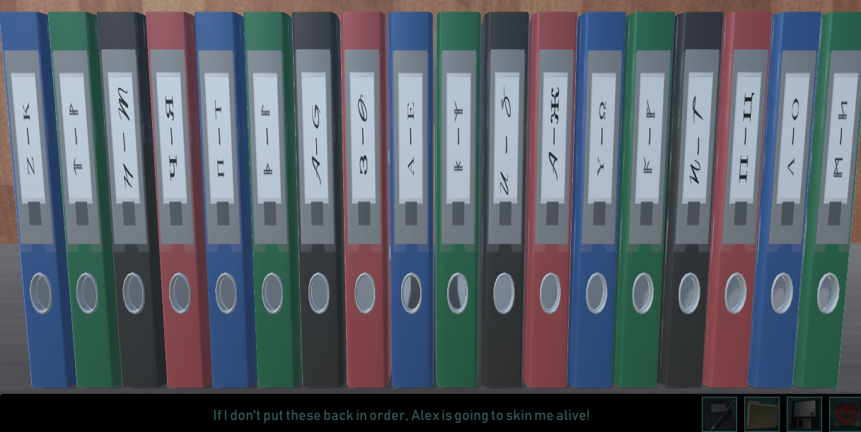

Slide 9
